Slide 1


MINI PROJECT
PRESENTATION
Guided by Prof. Javed
Presented by
Radhika Gupta - IIT2021125
Mani Kumar Baitha - IIT2021138
Naman Gupta - IIT2021139
Naysha Singh - IIT2021140
Bilolikar Shruti Upendra - IIT2021172

Slide 2
TABLE OF CONTENTS
Introduction
What is altered text detection in images ?
Significance
Scope
Base Research Paper
Proposed Modifications
Comparisons
References

Slide 3

INTRODUCTION
As more and more office documents are captured, stored, and shared in digital format, and as image editing software are becoming increasingly more powerful, there is a growing concern about document authenticity. To prevent illicit activities, this paper presents a new method for detecting altered text in document images
Altered text detection remains challenging, especially in diverse document types. The need for detection arises from potential disturbances introduced during text alteration, such as distortions, pattern irregularities, or pixel-level content misplacement.

Slide 4
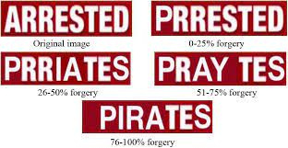
WHAT IS ALTERED TEXT DETECTION IN IMAGES ?
Altered text detection in images refers to the process of identifying and verifying text that has been manipulated, modified, forged, or tampered within images.

Slide 5
WHAT IS ITS SIGNIFICANCE ?
Forensic Investigations
Fraud Prevention
Financial Security
Content Integrity on Social Media
Document Validation in Government and Administration
Preventing Cybercrime
Protecting Intellectual Property

Slide 6
SCOPE OF OUR PROBLEM
Copy paste and insertion forgeries are common types of forgeries present in images. Since the advancement of photo editing softwares, these kind of alterations can be applied by any individual. Through our model ,we would try to detect these types of forgeries.

Slide 7
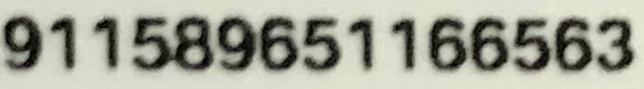
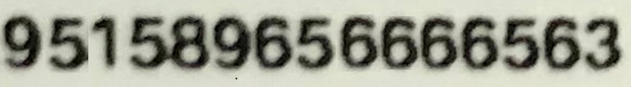
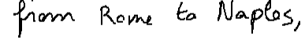
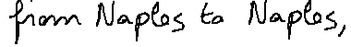
WHAT IS COPY-PASTE FORGERY ?
In copy-paste operation, the fraudster extracts desired text from a different document or a different location in the same document to be altered

Slide 8
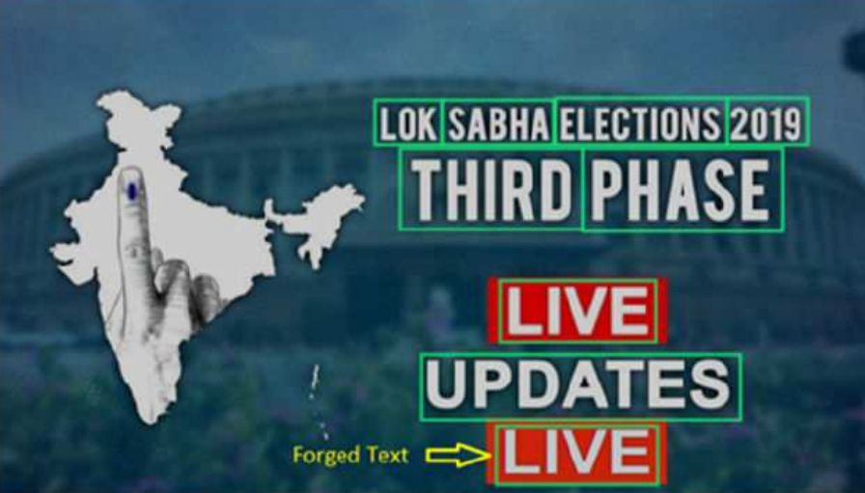
WHAT IS INSERTION FORGERY ?
In insertion operation, software tools are used to insert words to change the original text.

Slide 9
LITERATURE REVIEW
S.No | Paper title | Year | Methodology used | Accuracy
1 | DCT-phase statistics for forged IMEI numbers and air ticket detection | 2020 | Phase spectrum using the Discrete Cosine Transform (DCT). | 70
2 | A New RGB Based Fusion for Forged IMEI Number Detection in Mobile Images (Base Paper) | 2018 | Fusion-based approach using R, G and B color components. | 64
3 | A new forged handwriting detection method based on Fourier spectral density and variation | 2019 | Using variation in Fourier spectral density | 58
4 | Automated Forgery Detection in Multispectral Document Images using Fuzzy Clustering | 2018 | Using Fuzzy C-means Clustering | 61
5 | Analysis of Copy Move Image Forgery Detection Using Histogram of Orientated Gradient | 2018 | Automatic Image Forgery detection using HOG | 75

Slide 10
BASE RESEARCH PAPER[3]
“A New RGB based Fusion for Forged IMEI Number Detection in Mobile Images”
Palaiahnakote Shivakumara, V. Basavaraja, Harsha S. Gowda, D. S. Guru, Umapada Pal and Tong Lu
The proposed method explores a new fusion concept through variance and weights estimation for the respective color components, which results in fused images. The features based on sparsity, the number of connected components, and the average intensity of edge components in Canny and Sobel edge images of fused images are proposed. The relationship between the features of fused images and their input images helps us to separate forged IMEI numbers from the original ones.

Slide 11
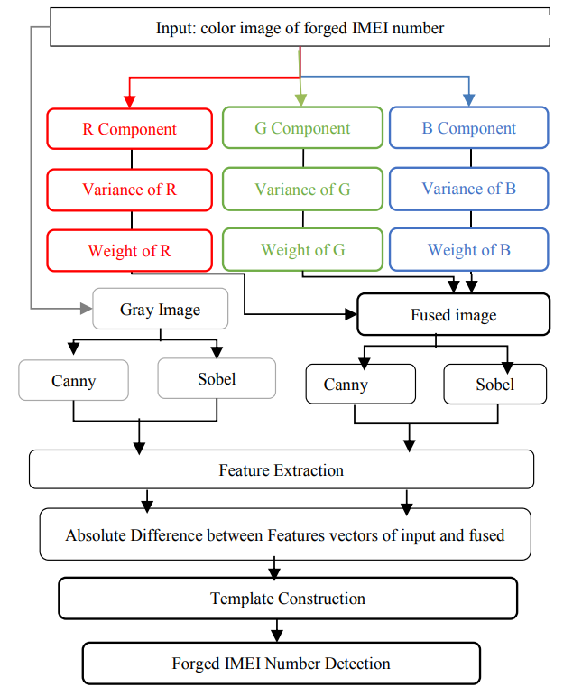
BASE RESEARCH PAPER[3]
Block Diagram for proposed methodology

Slide 12
BASE RESEARCH PAPER[3]
Here's a breakdown of the steps involved in the proposed approach:
Input Image Analysis:
Separate the input image into its three color components: Red (R), Green (G), and Blue (B).
Variance Calculation:
Calculate variances for the R, G, and B images independently. This step aims to identify local changes in each color component.
Weight Derivation:
Derive weights based on the calculated variances for each color component. These weights will be used in subsequent convolution operations.

Slide 13
BASE RESEARCH PAPER[3]
Convolution Operation:
Convolve the derived weights with the respective pixel values of the R, G, and B components. This process results in a fused image that emphasizes certain local changes based on the calculated weights.
Feature Extraction:
Extract features from the fused image based on:
Sparsity
Number of connected components
Average intensity values for edge components
Perform this extraction separately for each of the R, G, and B components, resulting in six features in total.
Feature Vector Generation:
Combine the six extracted features into a feature vector.

Slide 14
BASE RESEARCH PAPER[3]
Difference Calculation:
Find the absolute difference between the fused image and the original input image. This step results in a feature vector containing six difference values.
Template Construction:
Construct templates based on randomly chosen samples. These templates serve as reference patterns for genuine images.

Slide 15
BASE RESEARCH PAPER DATASET
IMEI number dataset:
Forged IMEI number detection provides 500 forged and 500 original images. This dataset, which is captured using mobile phone cameras, is challenging because images contain complex backgrounds compared to the other datasets we used.

Slide 16
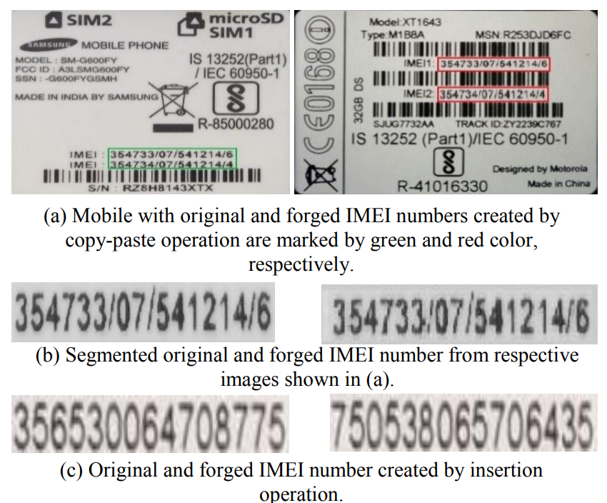
BASE RESEARCH PAPER-DATASET

Slide 17
LIMITATIONS OF BASE MODEL[3]
In instances where the input IMEI number encounters noise or blurring, low contrast, and multiple adverse factors, the effectiveness of the proposed method in correctly identifying forged texts diminishes. This visualization reveals misclassified images across the database. Hence, it's evident that there exists an opportunity for future improvements and developments in this domain.

Slide 18
PROPOSED MODIFICATIONS
Inspired by the knowledge that Discrete Cosine Transform (DCT) Coefficients have the ability to identify minute changes in image content. In this work, we propose to explore DCT coeffcients for detecting altered texts in document images.
Along with RGB color information. we have also applied DCT (Discrete Cosine Transform)to obtain a fused image from an input image.
The fusion combines images in the frequency and spatial domains for feature extraction. Next, histogram-based features are extracted from the fused image. The extracted features are then passed to a deep neural network classifier for detecting altered texts.

Slide 19
Here's a breakdown of the steps involved in the modified approach:
DCT Coefficient Classification and Image Reconstruction:
Apply DCT to original and altered images, classifying coefficients as positive and negative.
Reconstruct images by applying inverse DCT to positive and negative coefficients separately, resulting in two different images.
Laplacian Filtering:
Perform Laplacian filtering over each reconstructed image of positive and negative coefficients separately.
This eliminates pixels representing unwanted noise, enhancing text pixels.
PROPOSED MODIFICATIONS

Slide 20
PROPOSED MODIFICATIONS
Positive and Negative DCT Coefficient Fusion (PNDF):
Fuse Laplacian-filtered images of positive and negative coefficients using adaptive weighted variance.
Calculate variances for each window over the Laplacian positive and negative images.
Use the same variance as a weight in the fusion process.
RGB Color Channels Fusion (RGBF):
Utilize RGB color space for altered text detection.
Apply the same fusion operation as in PNDF to RGB color space, yielding sharp edges for characters in original images and blurred edges for characters in altered images.

Slide 21
PROPOSED MODIFICATIONS
Final Fusion and Residual Image:
Fuse PNDF and RGBF to generate final fused images.
Obtain the residual image by subtracting the fused image from the input image.
Feature Extraction:
Compute histograms for original, altered, fused, and residual images.
Extract feature vectors from the histograms, resulting in a total of 50 feature vectors.
Convolutional Neural Network (CNN) for Detection:
Pass the extracted 50 feature vectors to a CNN for altered text detection.
Use ReLU activation for intermediate layers, Sigmoid activation for the final layer, and Batch Normalization.
Train the CNN using Adam optimizer, binary cross-entropy loss, and a dropout rate of 0.2 for 100 epochs.

Slide 22
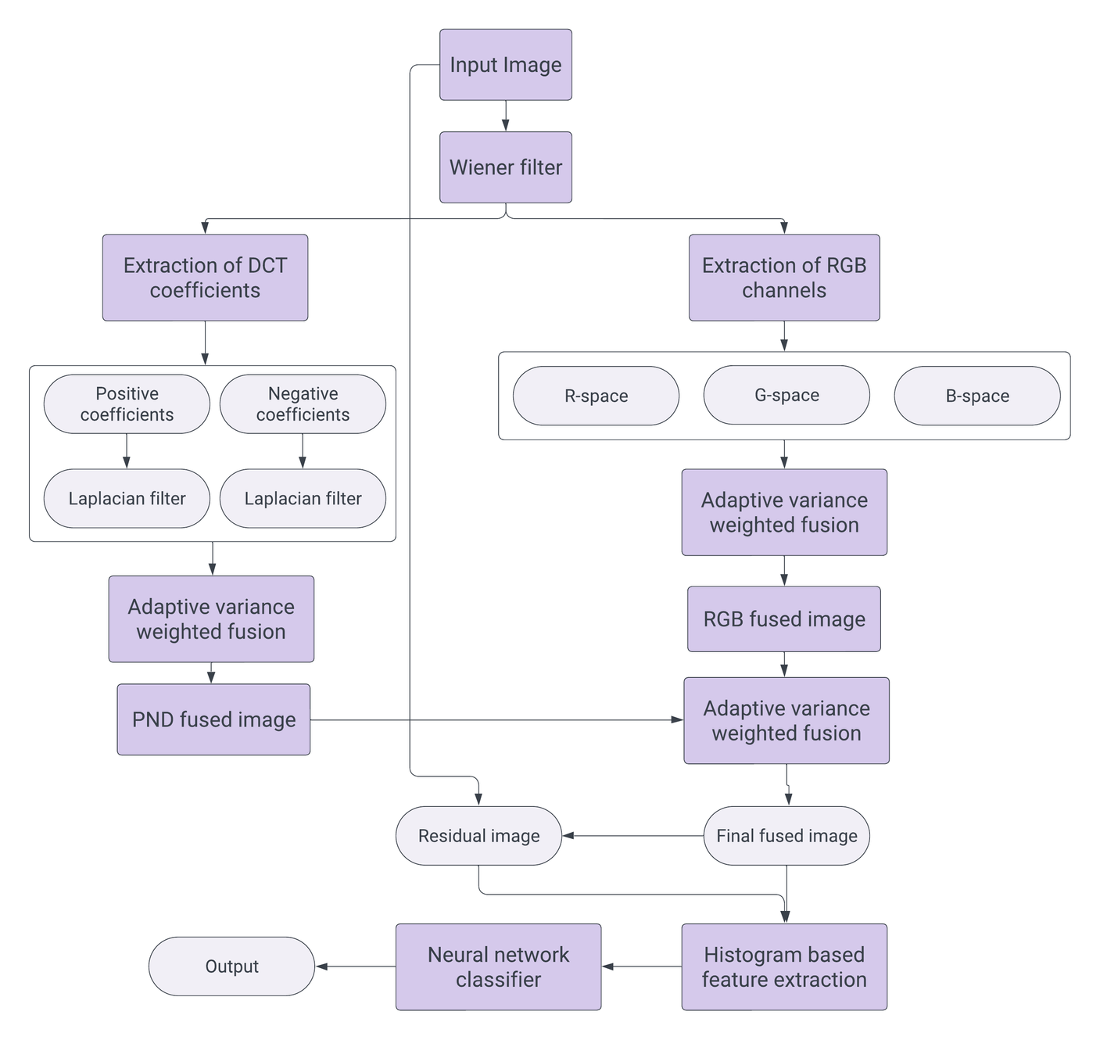
FRAMEWORK OF THE PROPOSED MODIFICATIONS

Slide 23
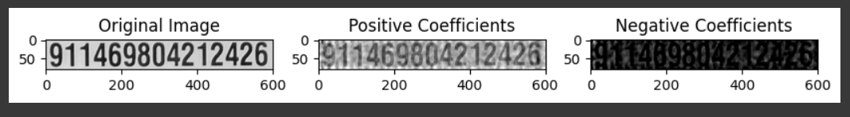
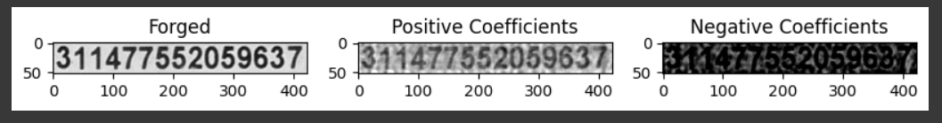
POSITIVE AND NEGATIVE DCT COEFFICIENTS

Slide 24
DCT COEFFICIENTS FUSION OPERATION

Slide 25
EXTRACTION OF RGB CHANNELS AND FUSED RGB IMAGE

Slide 26
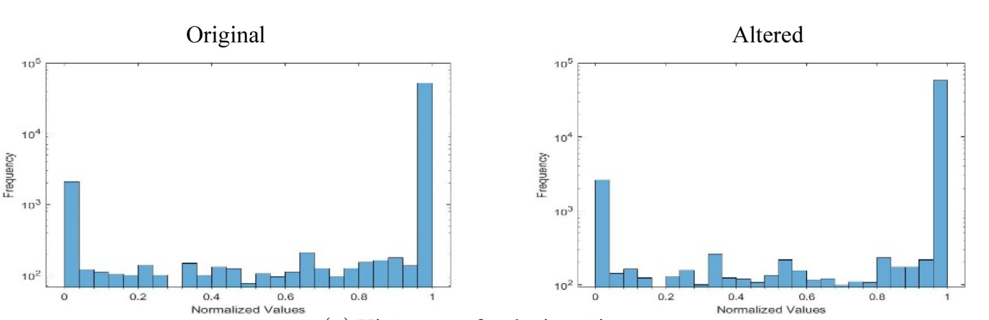
FUSION OPERATION

Slide 27
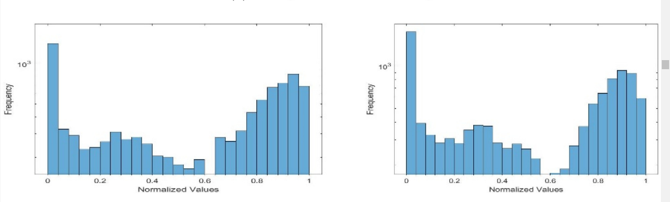
FUSION OPERATION
Affter fusion- original image
Affter fusion- forged image
Your paragraph text

Slide 28
COMPARISON WITH OTHER METHODS
Methods | IMEI Dataset
Kundu et al[4] | 58.0
Wang et al[5] | 78.8
Shivakumara et al[2] | 84.3
Base Paper[3] | 74.8
Proposed Approach | 77.45

Slide 29
CONCLUSION
The scope of feedback for the project on Detecting Altered Text in Document Images encompasses various aspects, including technical improvements, user experience enhancements, and considerations for broader deployment. Here are key areas for feedback
1. Technical Accuracy and Performance: - Evaluate the accuracy of the Proposed model in providing relevant and correct answers for unseen data and text Images. But for too blurry and noisy images our model may get confused and this is a challenging part of our work.
2.Model is domain specific- will not provide good results on handwritten images because of variation in handwriting styles.Also in scene text images bacause of variation in background, it will not give satisfactory results.

Slide 30
REFERENCES
[1] L. Nandanwar et al., "A Conformable Moments-Based Deep Learning System for Forged Handwriting Detection," in IEEE Transactions on Neural Networks and Learning Systems, 2022, doi: 10.1109/TNNLS.2022.3204390.
[2] Nandanwar, Lokesh & Shivakumara, Palaiahnakote & Kanchan, Swati & Basavaraja, Venkappanavara & Guru, Devanur & Pal, Umapada & Lu, Tong & Blumenstein, Michael. (2021). DCT-phase statistics for forged IMEI numbers and air ticket detection. Expert Systems with Applications. 164. 114014. 10.1016/j.eswa.2020.114014.
[3] Shivakumara, Palaiahnakote & Basavaraja, Venkappanavara & Gowda, Harsha & Guru, Devanur & Pal, Umapada & Lu, Tong. (2018). A New RGB Based Fusion for Forged IMEI Number Detection in Mobile Images. 386-391. 10.1109/ICFHR-2018.2018.00074.
[4] Kundu, Sayani & Shivakumara, Palaiahnakote & Grouver, Anaica & Pal, Umapada & Lu, Tong & Blumenstein, Michael. (2020). A New Forged Handwriting Detection Method Based on Fourier Spectral Density and Variation. 10.1007/978-3-030-41404-7_10.

Slide 31
REFERENCES
[5] Z. Wang, P. Shivakumara, T. Lu, M. Basavanna, U. Pal and M. Blumenstein, Fourier?residual for printer identi¯cation, in Proc. ACPR (2017), pp. 1114–1119.

